Slide 1
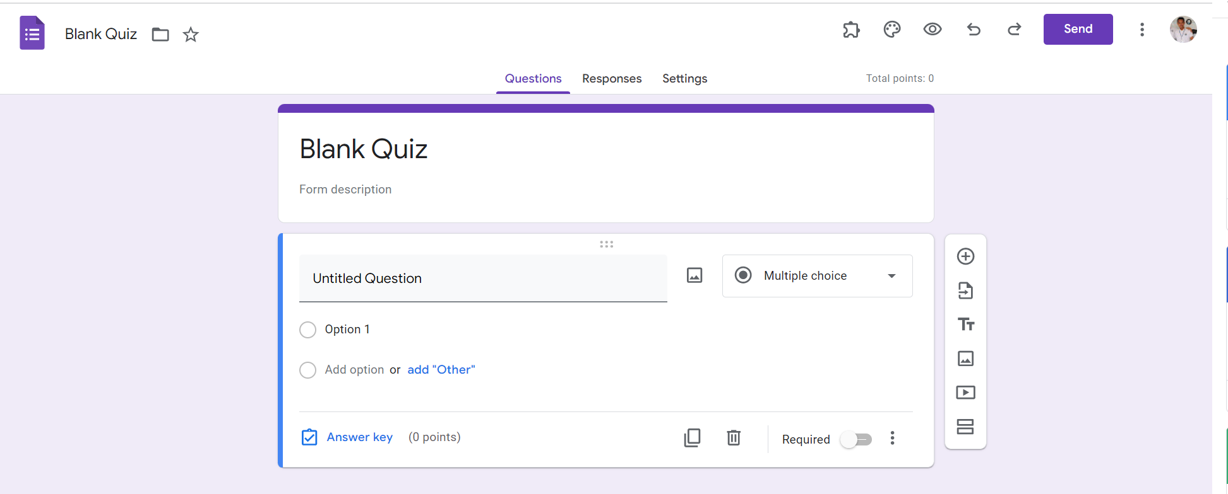
Identify root components of website below

Slide 2
Identify of Google form
Navigation
Flex:0
Header
Flex:1
Contain
Display: Flex
Flex-direction

Slide 3
Nav-left
Nav-right
div
div
div
div
Width: 30%
Width: 70%

Slide 4
Display : Flex
Flex-direction: Column
div
div
div
div
Logo
icon
icon
icon
icon
icon
icon
button
Logo
icon
link
link
link
text
Align-self: End
Align-self: End

Slide 5
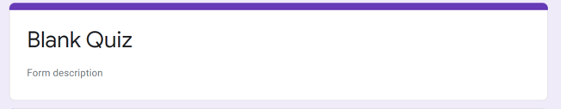
Logo
Text
Display: flex
Flex-direction: Column

Slide 6
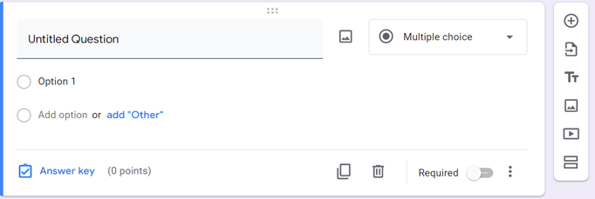
Main
Sub main
icon
Text(input)
icon
button
icon
button
icon
icon
icon
button
icon
icon
icon
icon

Slide 7
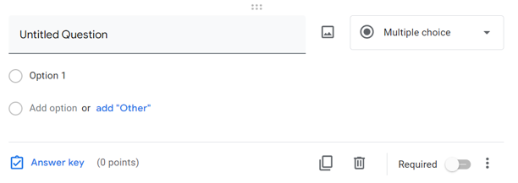

icon
Text(input)
icon
button
icon
button
icon
icon
icon
button
icon
icon
icon
icon
Display: Flex
Flex-direction: Column

